Slide 1
Function Calling
Hailiang Chen
HKU Business School

Slide 2
LLM Use Cases and Tasks
Source: DeepLearning.AI / AWS

Slide 3
Function Calling
Definition:
Function calling refers to the process of invoking a specific function or method within a program to perform a task.
Key Concepts:
Parameters: Inputs that the function requires to execute.
Return Values: Outputs that the function provides after execution.
Importance:
Enables modular programming, allowing complex tasks to be broken down into simpler, reusable functions.

Slide 4
Role of Function Calling in LLMs
Enhancing Model Capabilities:
Function calling allows LLMs to perform specific tasks more efficiently by delegating responsibilities to defined functions.
Examples of Tasks:
Data Retrieval: Accessing and returning specific information from a database or knowledge base.
Performing Calculations: Executing mathematical operations or complex computations based on user input, enhancing decision-making and analysis.
Scheduling and Reminders: Managing user calendars by setting appointments, sending reminders, and checking availability, enhancing personal productivity.

Slide 5
Technical Implementation Steps
Input Parsing
Function Identification
Parameter Extraction
Function Invocation
Output Generation
Context Management

Slide 6
Technical Implementation Steps
Input Parsing:
The model receives user input and identifies the intent behind the request.
It analyzes the text to determine if a function call is needed based on keywords or context.
Function Identification:
The model matches the identified intent with predefined functions available for execution.
This involves checking the function names, descriptions, and required parameters.
Parameter Extraction:
Relevant parameters are extracted from the user input to prepare for the function call.
This may include validating the data type and ensuring all required parameters are present. 类似天气，parameter输出温度等参数

Slide 7
Technical Implementation Steps
Function Invocation:
The appropriate function is called with the extracted parameters.
This step may involve interacting with external APIs or internal logic to execute the function.
Output Generation:
The results from the function call are processed and formatted for user-friendly output.
The model generates a coherent response based on the function’s output, integrating it into the conversation.
Context Management:
The model maintains context throughout the interaction, ensuring that subsequent requests are informed by previous exchanges.
This helps in providing relevant and accurate responses in ongoing conversations.具备记忆，整合所有的信息
LLM识别需要的function需要calling
第二次：整合获取到的信息，输出

Slide 8
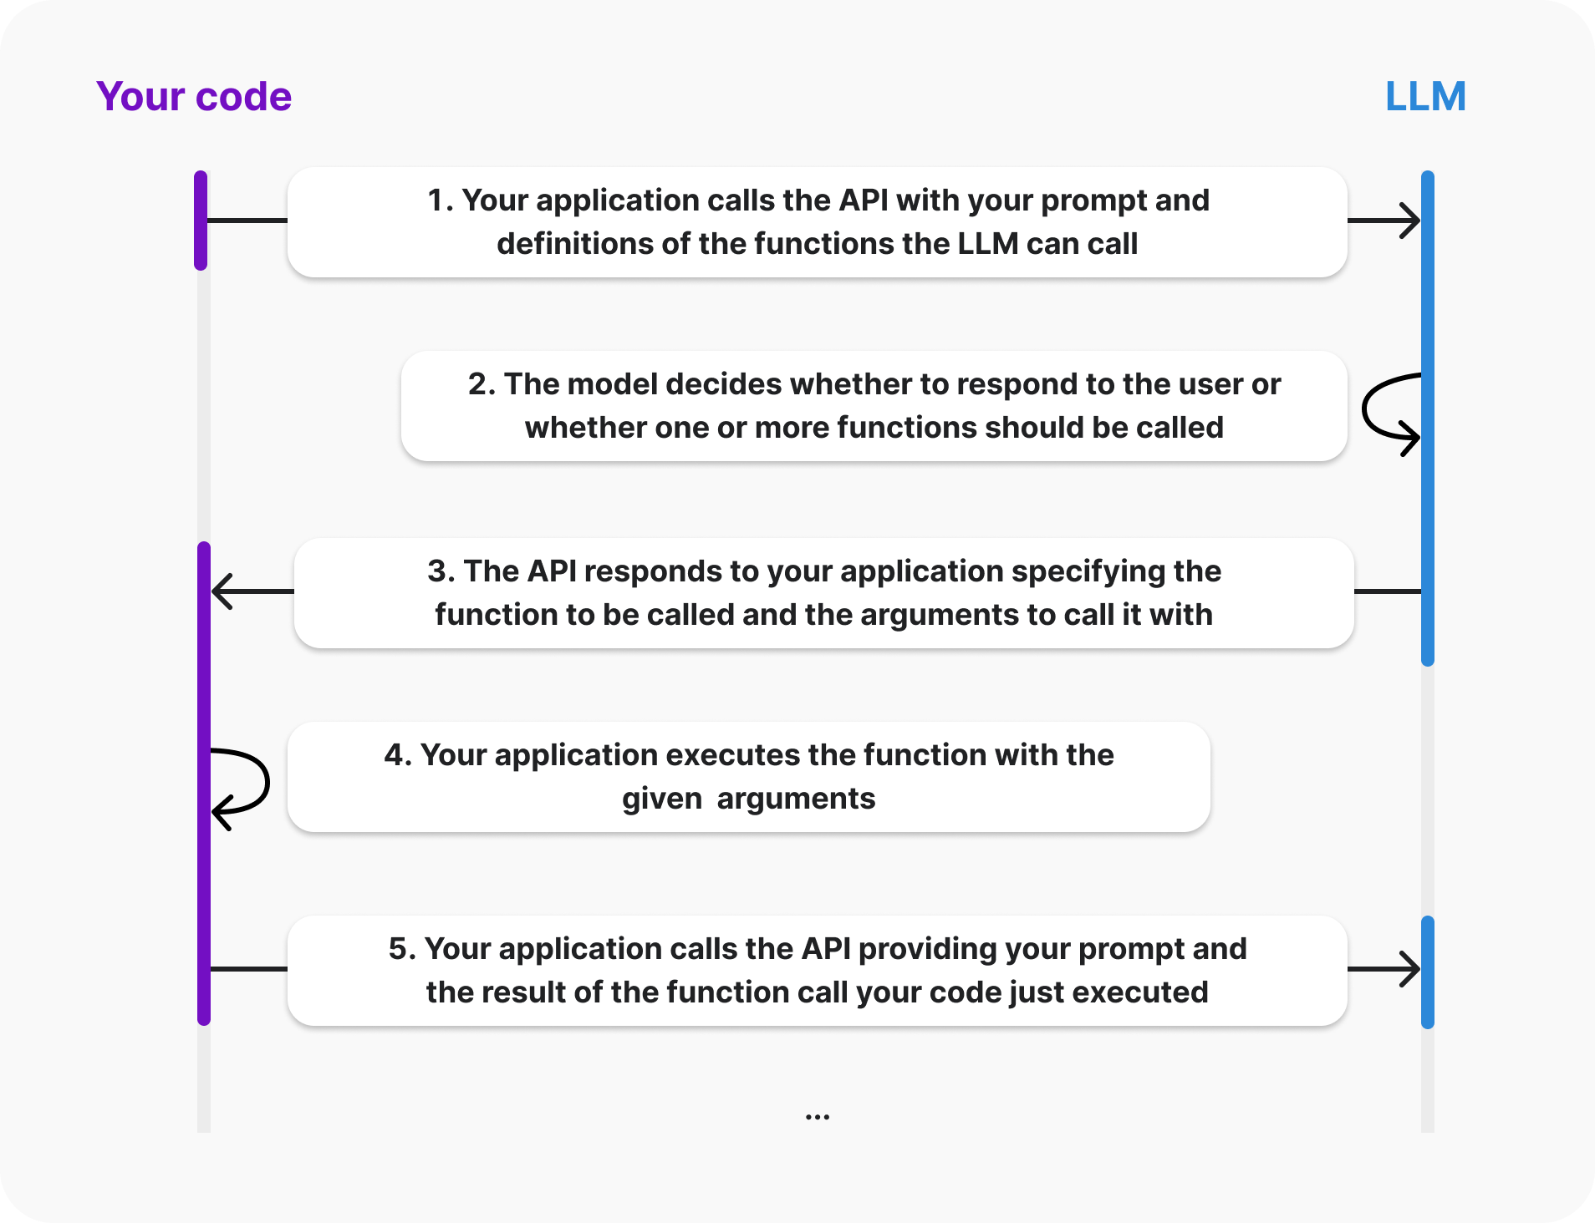

Slide 9
Function calling example
Single function: function_call.py
Multiple functions: function_call2.py query中涉及多个function
parralle functon invoke
Reference: https://learn.microsoft.com/en-gb/azure/foundry/openai/how-to/function-calling?tabs=python-api-key

Slide 10
Single function calling
Model's response:
ChatCompletionMessage(content=None, role='assistant', function_call=None, tool_calls=[ChatCompletionMessageToolCall(id='call_UH0cMT9Wa7IIQ1rQXXrkh23H', function=Function(arguments='{"location":"San Francisco"}', name='get_current_time'), type='function')])
Function arguments: {'location': 'San Francisco'}
get_current_time called with location: San Francisco
Timezone found for san francisco
The current time in San Francisco is 12:32 AM.

Slide 11
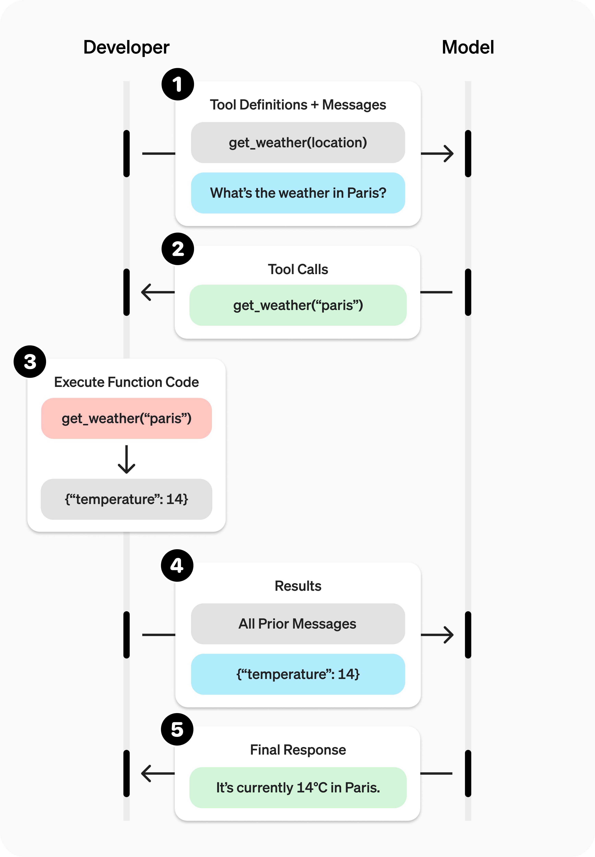
Real-time Weather Info
Source: OpenAI

Slide 12
Parallel function calling
gpt-4 (2024-04-09)
gpt-4o (2024-05-13)
gpt-4o (2024-08-06)
gpt-4o (2024-11-20)
gpt-4o-mini (2024-07-18)
gpt-4.1 (2025-04-14)
gpt-4.1-mini (2025-04-14)
gpt-5 (2025-08-07)
gpt-5-mini (2025-08-07)

Slide 13
Parallel function calling
# Single function call
#messages = [{"role": "user", "content": "What's the current time in San Francisco"}]
# Parallel function call with a single tool/function defined
messages = [{"role": "user", "content": "What's the current time in San Francisco, Tokyo, and Paris?"}]

Slide 14
Parallel function calling
Model's response:
ChatCompletionMessage(content=None, role='assistant', function_call=None, tool_calls=[ChatCompletionMessageToolCall(id='call_oSCSI8NGy5LaETNOB8L8tBjf', function=Function(arguments='{"location": "San Francisco"}', name='get_current_time'), type='function'), ChatCompletionMessageToolCall(id='call_cqWAfjNSi1zyrzxc3qJoQlLF', function=Function(arguments='{"location": "Tokyo"}', name='get_current_time'), type='function'), ChatCompletionMessageToolCall(id='call_a2vN8lqFMnOVjnkknXBAGlP4', function=Function(arguments='{"location": "Paris"}', name='get_current_time'), type='function')])
Function arguments: {'location': 'San Francisco'}
get_current_time called with location: San Francisco
Timezone found for san francisco
Function arguments: {'location': 'Tokyo'}
get_current_time called with location: Tokyo
Timezone found for tokyo
Function arguments: {'location': 'Paris'}
get_current_time called with location: Paris
Timezone found for paris
The current time in San Francisco is 12:17 AM, in Tokyo is 05:17 PM, and in Paris is 09:17 AM.

Slide 15
Parallel function calling with multiple functions
messages = [{"role": "user", "content": "What's the weather and current time in San Francisco?"}]
同时calling 两个function # messages = [{"role": "user", "content": "What's the weather and current time in San Francisco and Paris?"}]

Slide 16
Parallel function calling with multiple functions
Model's response:
ChatCompletionMessage(content=None, role='assistant', function_call=None, tool_calls=[ChatCompletionMessageToolCall(id='call_Rw45VSU2FWcbNAGU2F95jI2W', function=Function(arguments='{"location": "San Francisco", "unit": "celsius"}', name='get_current_weather'), type='function'), ChatCompletionMessageToolCall(id='call_PAlavgX0GpVN1Ofd49waSUj3', function=Function(arguments='{"location": "San Francisco"}', name='get_current_time'), type='function')])
Function call: get_current_weather
Function arguments: {'location': 'San Francisco', 'unit': 'celsius'}
get_current_weather called with location: San Francisco, unit: celsius
Weather data found for san francisco
Function call: get_current_time
Function arguments: {'location': 'San Francisco'}
get_current_time called with location: San Francisco
Timezone found for san francisco
The current weather in San Francisco is 72°C and the current time is 12:49 AM.

Slide 17
Parallel function calling with multiple functions
Model's response:
ChatCompletionMessage(content=None, role='assistant', function_call=None, tool_calls=[ChatCompletionMessageToolCall(id='call_vHUWwd5v1cgAeEqIY2OXZMfF', function=Function(arguments='{"location": "San Francisco", "unit": "celsius"}', name='get_current_weather'), type='function'), ChatCompletionMessageToolCall(id='call_3Qb3ShQVtMag1AFI9PziUKP0', function=Function(arguments='{"location": "San Francisco"}', name='get_current_time'), type='function'), ChatCompletionMessageToolCall(id='call_DR9eGrUyssW0RDT6IAF8uguv', function=Function(arguments='{"location": "Paris", "unit": "celsius"}', name='get_current_weather'), type='function'), ChatCompletionMessageToolCall(id='call_3YpRGvRv5gjthzJIy4ZweJuE', function=Function(arguments='{"location": "Paris"}', name='get_current_time'), type='function')])
Function call: get_current_weather
Function arguments: {'location': 'San Francisco', 'unit': 'celsius'}
get_current_weather called with location: San Francisco, unit: celsius
Weather data found for san francisco
Function call: get_current_time
Function arguments: {'location': 'San Francisco’}
…
In San Francisco, the current weather is 72°C and the current time is 12:57 AM. In Paris, the current weather is 22°C and the current time is 09:57 AM.

Slide 18
Database Access
Demos: function_call_db.py and function_call_db_streamlit.py
SQLite database: fb.sqlite (62.4MB)
Tables
imdb_movie_overview: IMDb movie detail (including FB page id)
boxoffice: Weekly box office revenue
fbposts: Facebook page posts (i.e., posts by page owners)
fandango_review: Fandango movie reviews

Slide 19
SQLite Database
Database Management Tools
DB Browser for SQLite: https://sqlitebrowser.org/
Python package: sqlite3

Slide 20
Sample Enquiries
What's the movie id for Life of Pi?
Can you tell me about the movie tt0454876?
Show me the weekly box office revenue for tt0454876.
Add a new movie record to the database table imdb_movie_overview: imdb_id=tt1234567, title=My Movie, …
Delete the movie tt1234567.

Slide 21
Database Access Functions 根据你自己的业务逻辑添加function 原始代码非常多限制
add_movie
delete_movie
get_imdb_id_by_title
get_movie_overview
get_boxoffice
get_fbposts
get_fandango_reviews
function calling就是LLM和外界世界交互的基础，一句话总结

Slide 22
Challenges and Limitations
Context Management:
Maintaining context across multiple function calls can be complex, especially in lengthy interactions. The model may struggle to remember previous inputs or outputs, leading to potential misunderstandings.
Scalability:
As the number of functions increases, managing and integrating them into the model becomes more complex. Ensuring that the model can efficiently handle a wide range of functions without performance degradation is essential.
Error Handling:
When functions encounter errors (e.g., invalid inputs or API failures), the model must effectively manage these situations. Providing clear feedback to users about errors is crucial but can be challenging.

Slide 23
Challenges and Limitations
Dependency on External APIs:
Many function calls rely on external services or APIs. If these services experience downtime or changes in their interfaces, it can disrupt the functionality of the model.
Data Privacy and Security:
Function calls that involve sensitive data (e.g., personal information or financial data) raise privacy concerns. Implementing robust security measures to protect user data is critical.

Slide 24
Take-home Assignment 3
Replace the Chat Completions API with the Responses API in function_call.py and function_call2.py

Slide 25
Fine Tuning Functions
Fine-tuning and too calling: https://learn.microsoft.com/en-us/azure/foundry/openai/how-to/fine-tuning-functions
Fine Tuning with Function Calling on Azure OpenAI Service: https://techcommunity.microsoft.com/t5/ai-azure-ai-services-blog/fine-tuning-with-function-calling-on-azure-openai-service/ba-p/4065968

Slide 26
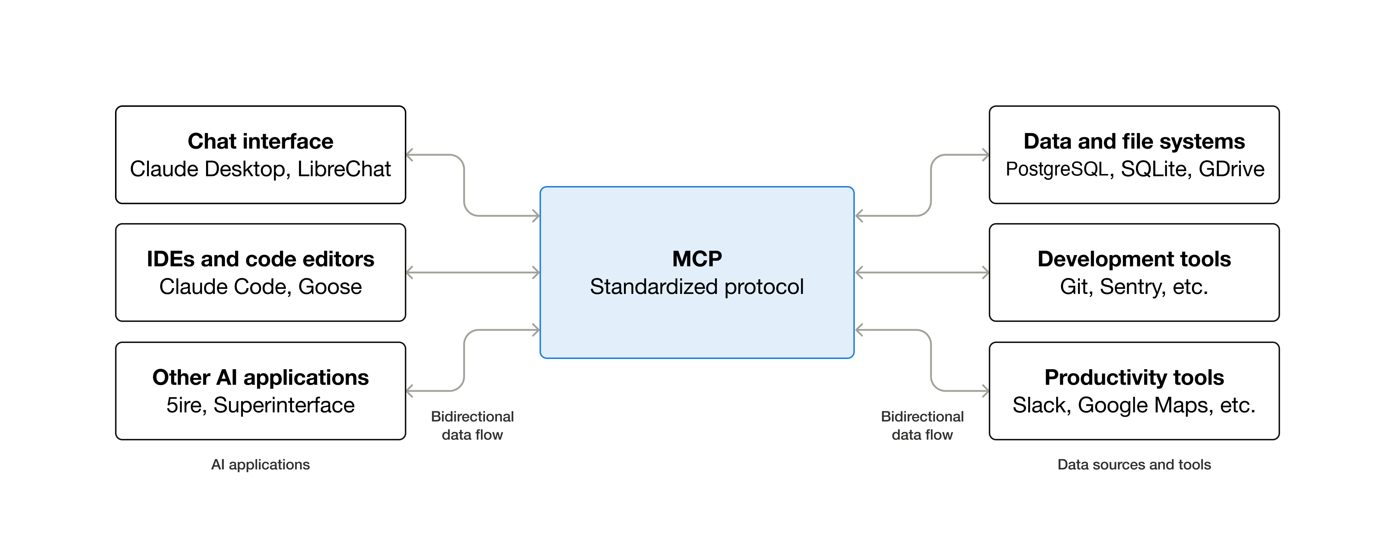
Model Context Protocol (MCP)

Slide 27
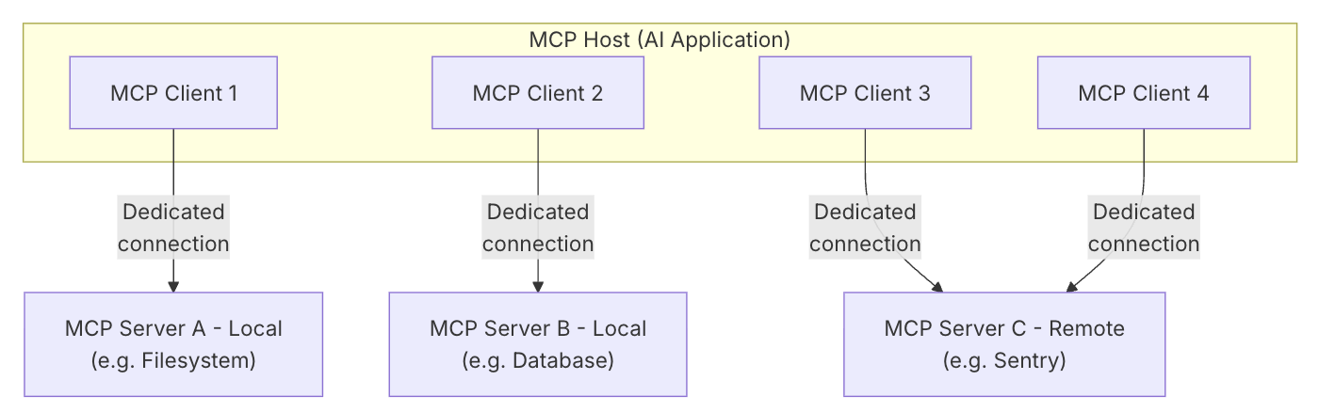
MCP Architecture

Slide 28
Microsoft Learn MCP Server
Endpoint: https://learn.microsoft.com/api/mcp
Functions:
Microsoft Docs Search: Search Microsoft’s official documentation (Learn, Azure, etc.) to quickly find relevant articles, how‑to guides, troubleshooting steps, and official explanations.
Microsoft Docs Fetch: Retrieve the full markdown content of a specific documentation page—useful for detailed procedures, code snippets, diagrams, and troubleshooting after identifying a page via search.
Microsoft Code Sample Search: Find official Microsoft code examples by querying SDKs, functions, or classes, with optional language filters (e.g., C#, Python, Azure CLI).

Slide 29
26/4/8Microsoft Learn MCP Server
Queries:
What functions are available
Show me the available regions for gpt-5-mini model on Azure
How to upgrade a free AI search resource on Azure
Python code: agent_mcp_mslearn.py
Initialize a MCP tool
Create an agent with access to this MCP tool
功能：含有最新LLM知识库方便查询

Slide 30
DefaultAzureCredential()
Register on Azure Portal and claim your free student subscription
Install Azure Command-Line Interface (CLI) on your computer
https://learn.microsoft.com/en-us/cli/azure/?view=azure-cli-latest
Run az login to login with your hku email address and select your student subscription
https://learn.microsoft.com/en-us/cli/azure/get-started-with-azure-cli?view=azure-cli-latest
Create a Foundry project on Azure and update the four environment variables starting with “FOUNDRY_PROJECT_” in the .env file
https://microsoftlearning.github.io/mslearn-ai-studio/Instructions/Exercises/01-Explore-ai-studio.html

Slide 31
GitHub MCP Server
Code: agent_mcp_github.py
Set up the MCP tool on the Tools page in Microsoft Foundry
Catalog: GitHub + your Personal Access Token in the Bearer field
Custom: Model Context Protocol (MCP)
Name: github-copilot (specified by you)
Remote MCP server endpoint: https://api.githubcopilot.com/mcp/
Authentication: Key-based
Key: Authorization
Value: your GitHub Personal Access Token

Slide 32
How to Create a GitHub Personal Access Token
Log in to your GitHub account.
Navigate to your profile picture in the upper-right corner and select Settings.
In the left sidebar, scroll down and click Developer settings.
In the left sidebar, under "Personal access tokens," select either Fine-grained tokens or Tokens (classic).
Click Generate new token (or Generate new token (classic)).
Provide a name and set an expiration date for the token.
Select the appropriate permissions/scopes required for your task. For command-line access to repositories, the repo scope is typically needed for classic tokens. For fine-grained tokens, you can select specific repositories and granular permissions.
Click Generate token.
Copy the generated token immediately. For security, you will not be able to see it again once you leave the page. Store it in a secure location, like a password manager.

